Slide 1
Expert System for Car Failure Diagnostics
Artificial intelligence
Grupo #2
RONNY MORÁN
GUSTAVO LONDA
RENATO ILLESCAS

Slide 2
Agends
Expert System
SHELLS for JAVA and RECOGNITION ALGORITHM
Shell Selected
Tools and Experts
DEMO

Slide 3
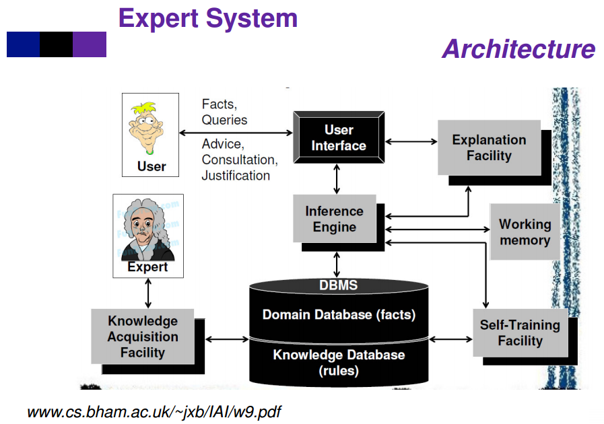
Expert System
Knowledge Base: Has the knowledge to formulate, understand and solve specific problems. It is composed of two basic elements: special heuristics and rules that govern the use of knowledge to solve specific problems of a particular domain.
Inference Engine: Is the control structure of an expert system, the Inference Engine is an automatic mechanism that allows to answer queries from the information that is in the Knowledge Base based on rules.
The inference engine conclude with the knowledge of the problem and its solution determines how the rules are applied.
User interfaces: Is interaction between the Expert System and the end user, and is done through natural language.

Slide 4
SHELLS for JAVA and RECOGNITION ALGORITHM
CLIPS (C Language Integrated Production System)
JESS (Java Expert System Shell) - Selected
PROLOG (Programming in Logic)
DROOLS (Business Rules Management System)

Slide 5
JESS
Backward and Forward Chaining
Algorithm Rete
If … then RULES
Why JESS?
The knowledge representation is write how IF - THEN rules are in the rules.clp file with the
inference engine backward chaining.

Slide 6
Tools and Experts
Tools
Netbeans IDE version 8.1
Java Programming Language, in which the Java expert system
Shell library (JESS) was added where the class jess.Rete is the engine of Inference
Experts members (Recommendation):
Ing. Cristian Arias - professor FIMCP ESPOL,
Ing. Sixto Alvarado - Supervision of truck maintenance at HOLCIM
Also we consulted in mechanical workshops.

Slide 7
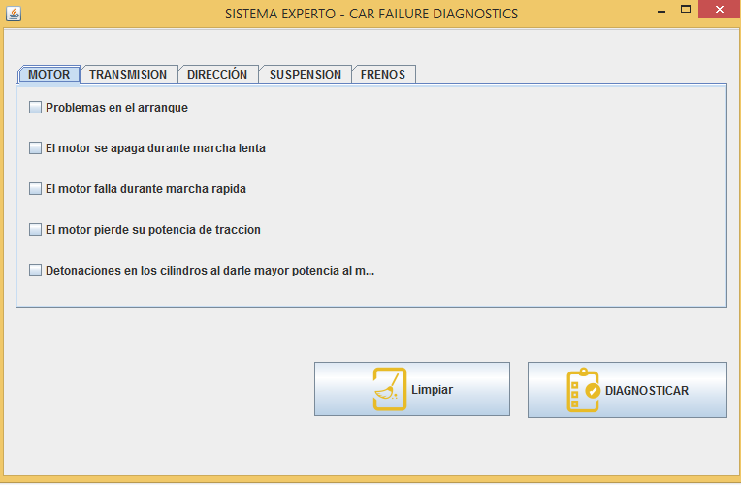
Expert System

Slide 8

Expert System - Select Fault

Slide 9
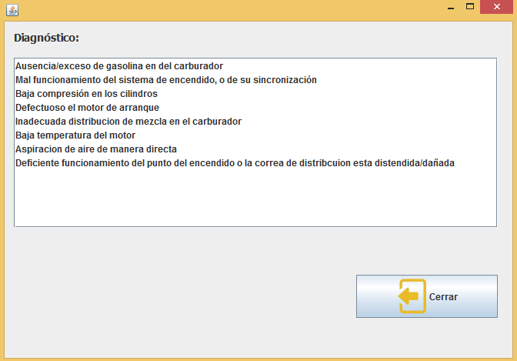
Expert System - Diagnostic

Slide 10
THANK YOU
:)

